Slide 1
Deep Learning - Image Classification with CNN Project
Group 1
Maria Eduarda de Mello Oliveira
Khushboo Shrivastava
Ramzi Ben Meftah
Aleksa Mihajlovic

Slide 2
Solution Overview
We trained two deep learning models to classify images from the CIFAR-10 dataset.
Model 1: A custom CNN built and trained from scratch - Test Acc ~ 87%
Model 2: A Transfer Learning model using MobileNetV2 pretrained on ImageNet - Test Acc ~ 90%
MobileNetV2 achieved higher accuracy, but required significantly more training time.

Slide 3
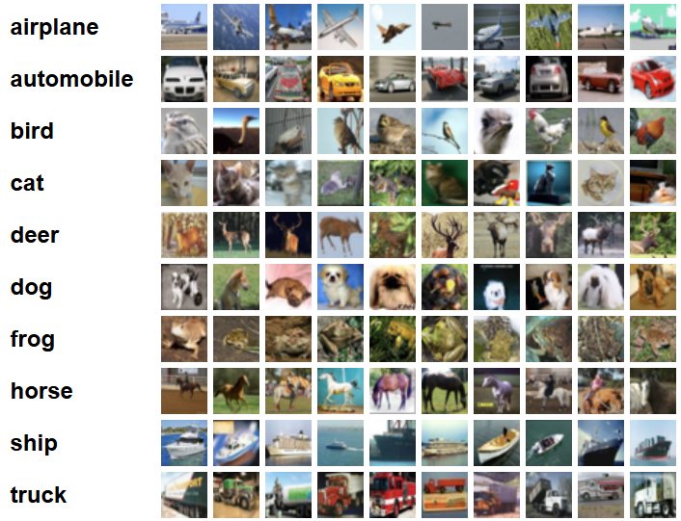
Dataset
CIFAR-10
60,000 images (32×32 RGB)
10 classes (e.g., airplane, dog, ship, etc.)
50,000 training images, 10,000 test images

Slide 4
Data Preprocessing
Key Steps
Normalization: Pixel values scaled from 0–255 → 0–1 using rescale=1./255.
Label Encoding: Converted labels to one-hot vectors for categorical cross-entropy training.
Data Augmentation: Applied only to the training data to increase variability and reduce overfitting:
Rotation (up to 15°)
Width and height shifts (10%)
Horizontal flip
Zoom (10%)
Purpose
Improve generalization
Reduce overfitting
Standardize input distribution

Slide 5
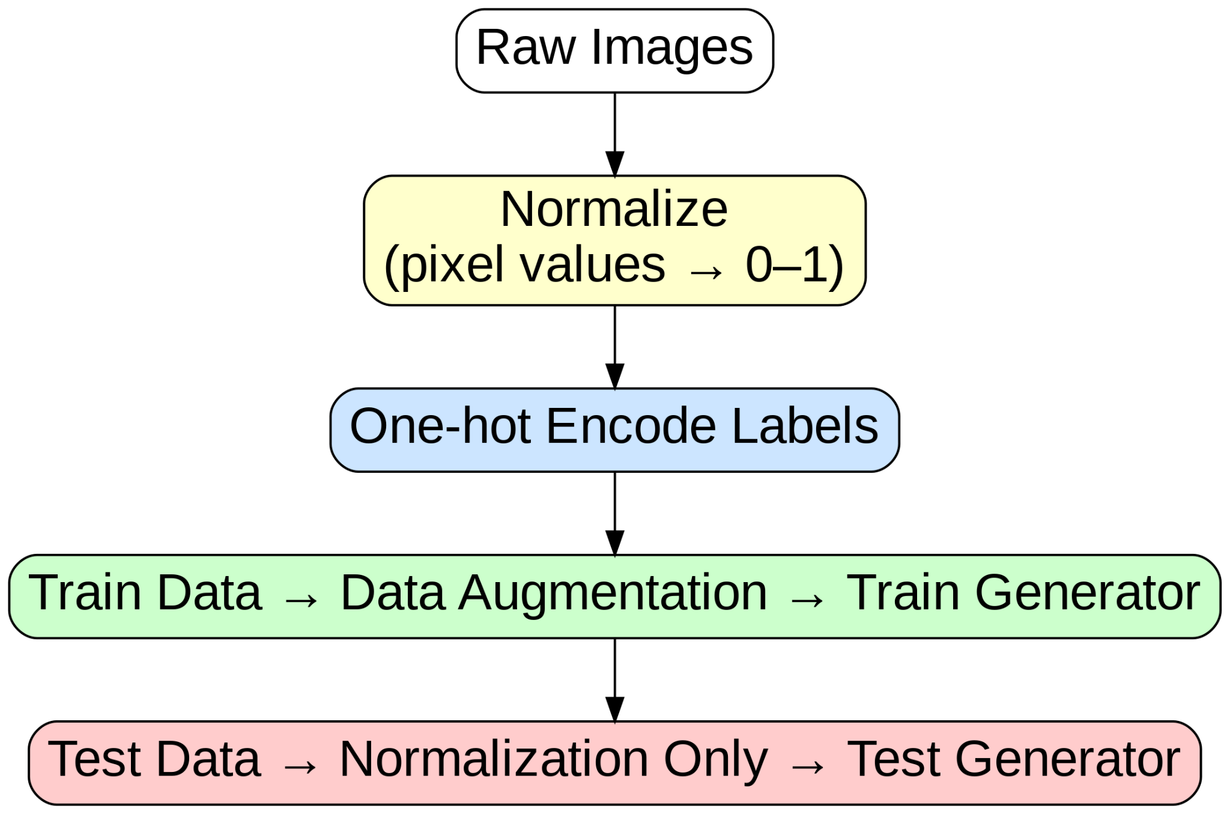
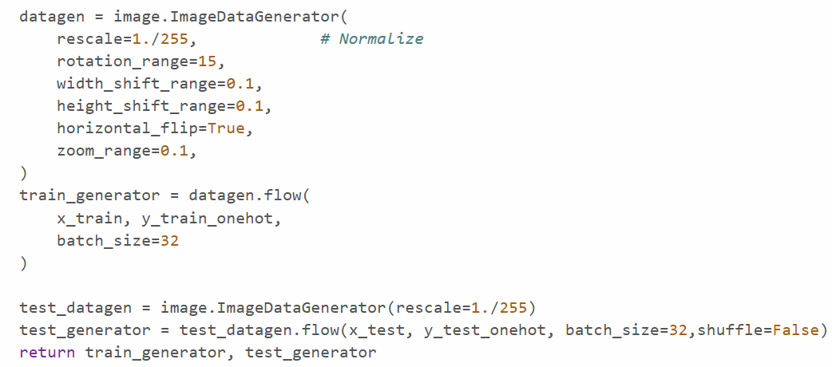
Data Preprocessing

Slide 6
CNN Architecture
Model Overview
Input: 32×32 RGB images
Feature Extraction:
Multiple Conv2D + ReLU blocks
Batch Normalization to stabilize training
MaxPooling to reduce spatial dimensions
Global Feature Aggregation:
Global Average Pooling (reduces overfitting vs Flatten)
Classification Head:
Dense layer with ReLU + Dropout (0.5)
Softmax output layer for 10 CIFAR-10 classes

Slide 7
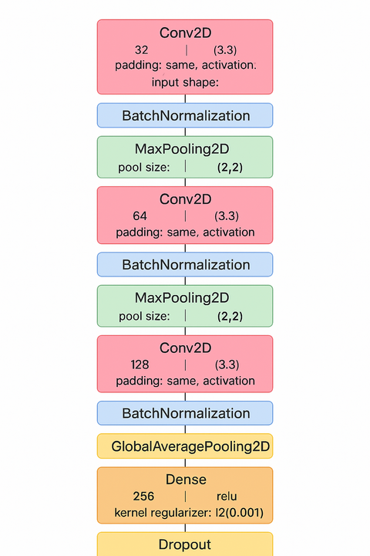
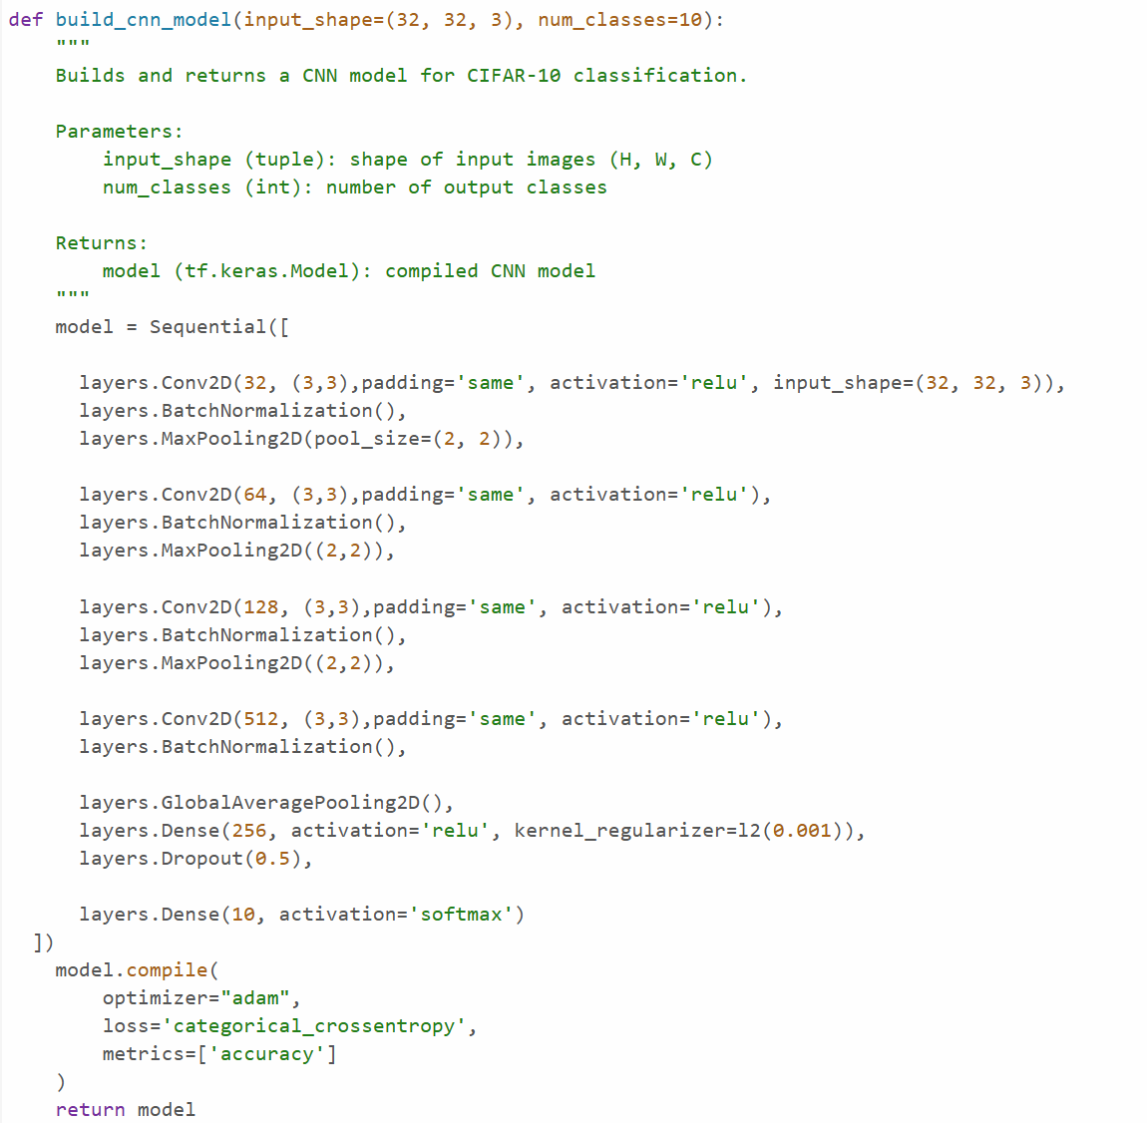
CNN Architecture

Slide 8
Optimization Techniques
Key Optimization Strategies Used
Adam Optimizer
Batch Normalization
Dropout (0.5)
L2 Regularization
Data Augmentation
Early Stopping
ReduceLROnPlateau

Slide 9
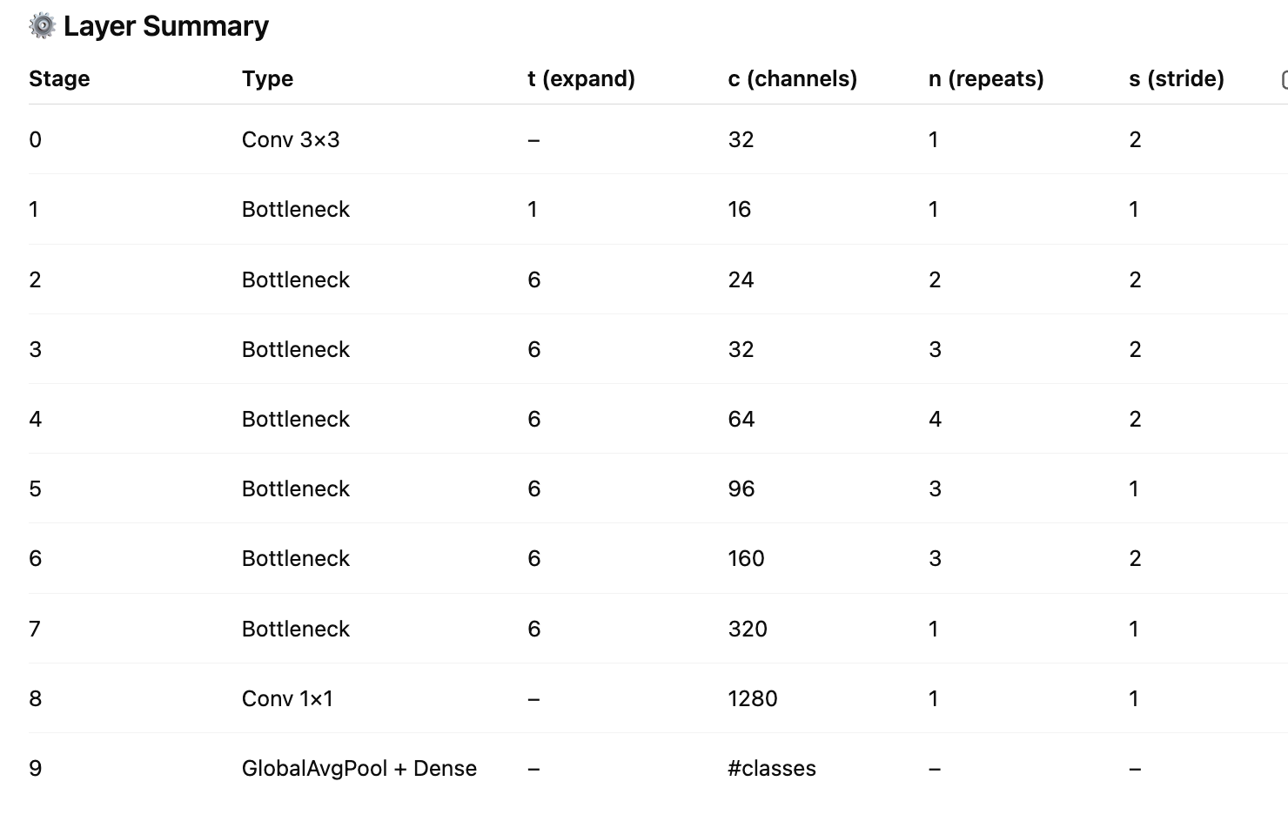
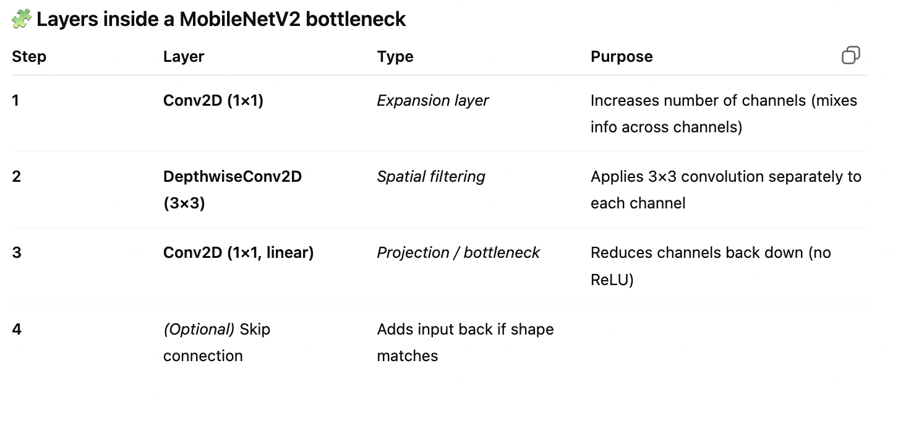
Transfer Learning
Pretrained Model:
MobileNet V2
Designed 2018 by Google for devices
with lightweight compute power
Architecture (55 Layers) —->
Added Layers:
Pretrained Model
GlobalAveragePooling2D()
Dropout(0.4)
Dense(256, activation='relu')
Dropout(0.4)
Dense(10, activation='softmax')

Slide 10
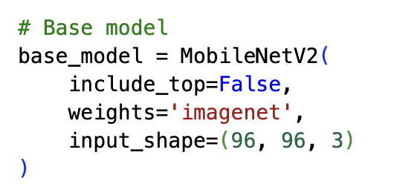
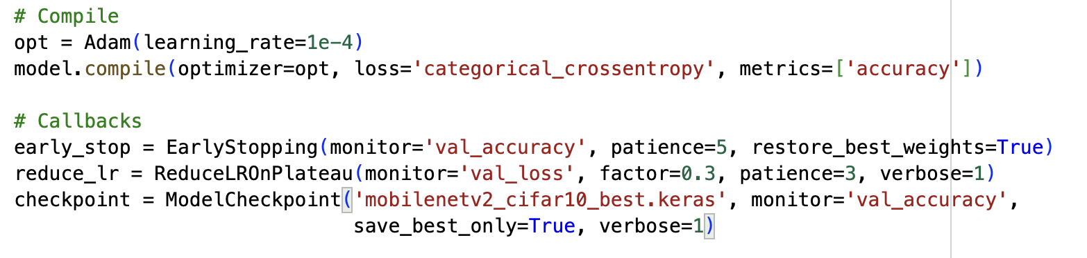
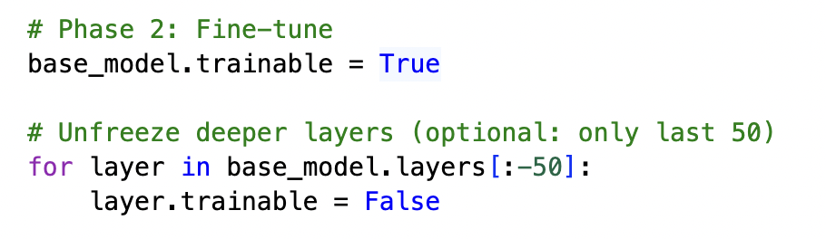
Transfer Learning
Taking out the last Dense layer, because it was for originally trained for ImageNet’s 1000 classes
Load pretrained weights from training on the ImageNet dataset (1.2 million images, 1000 classes)
The original MobileNetV2 expects 224×224 inputs (ImageNet standard). We can safely resize CIFAR-10 images (32×32 → 96×96) so that the model still works, while saving memory. It doesn’t work with 32x32
Early Stopping
Reducing the LR if loss doesn’t improve
We are training the Model in 2 iterations

Slide 11
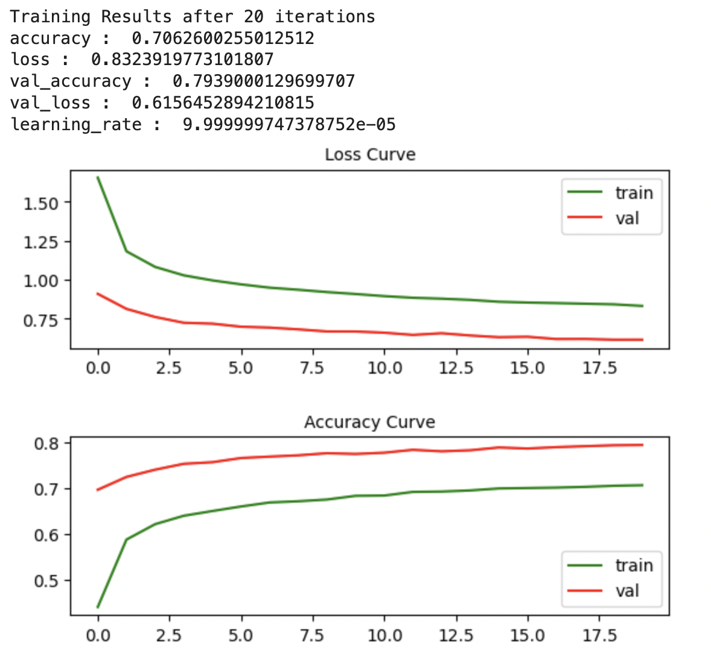
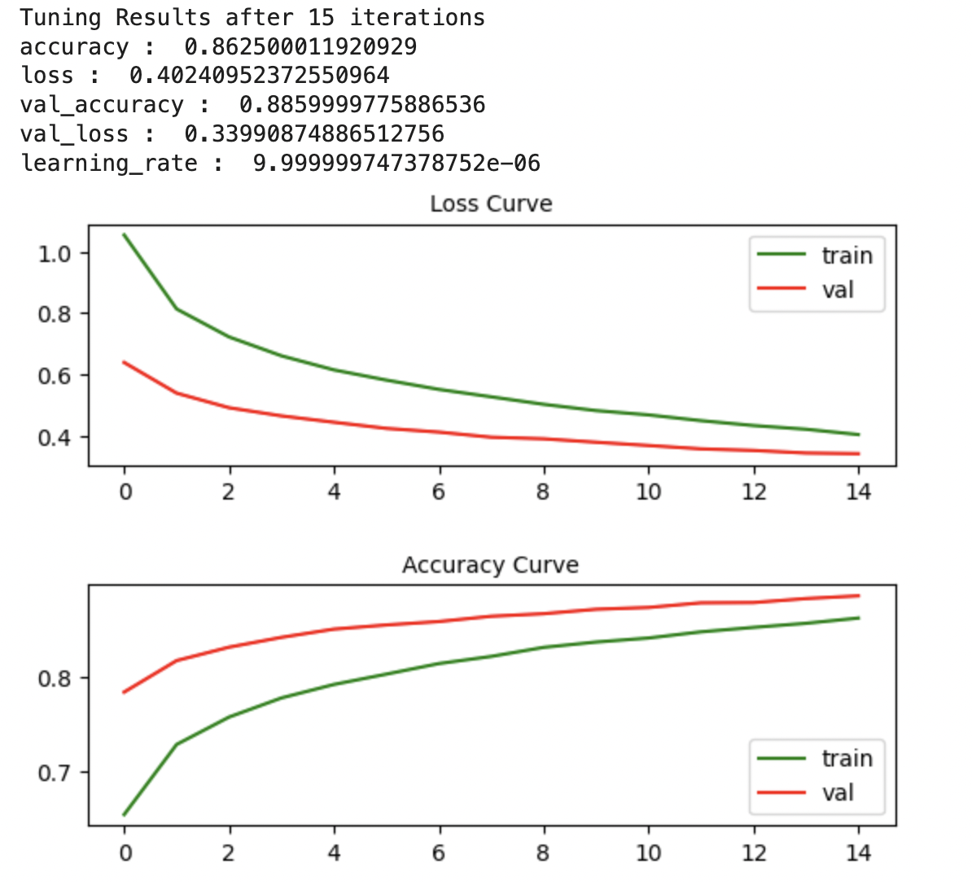
Transfer Learning

Slide 12
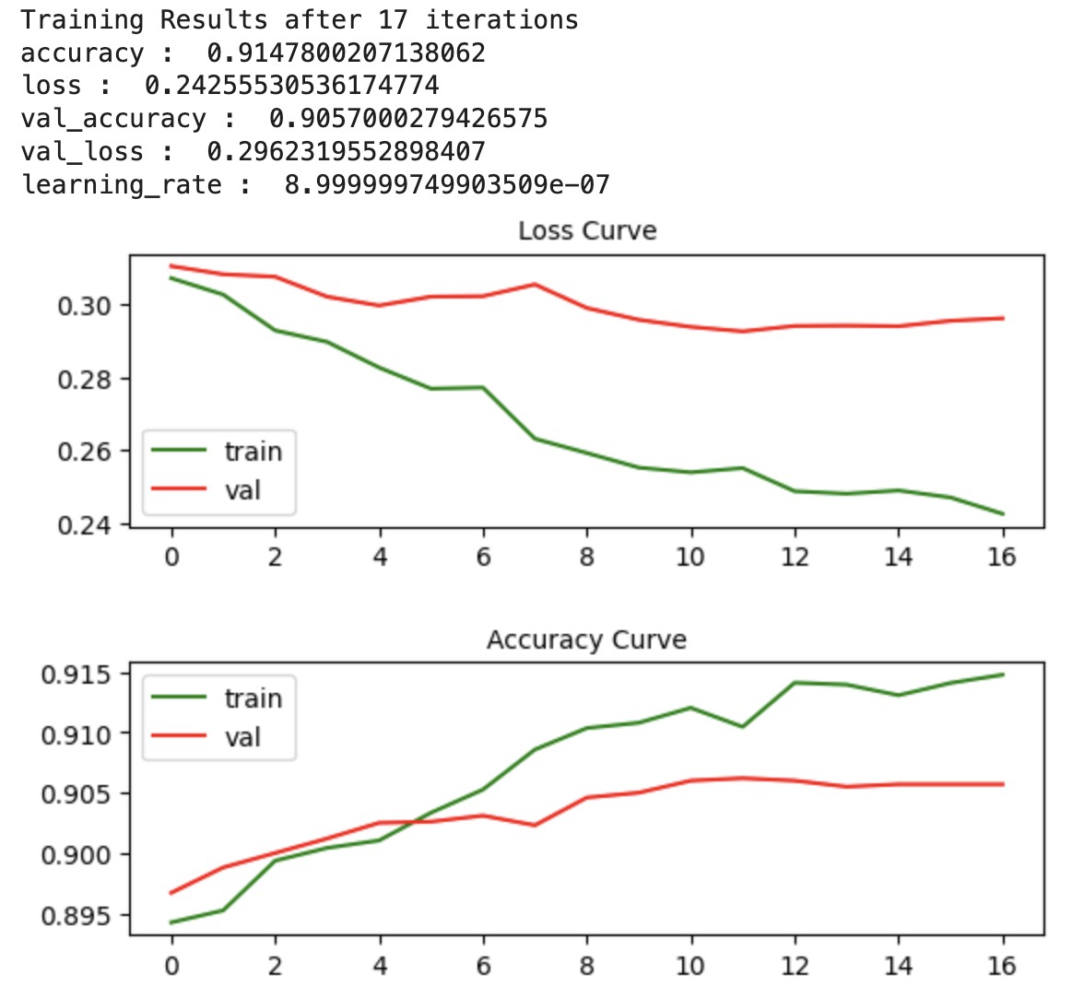
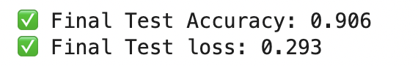
Transfer Learning

Slide 13
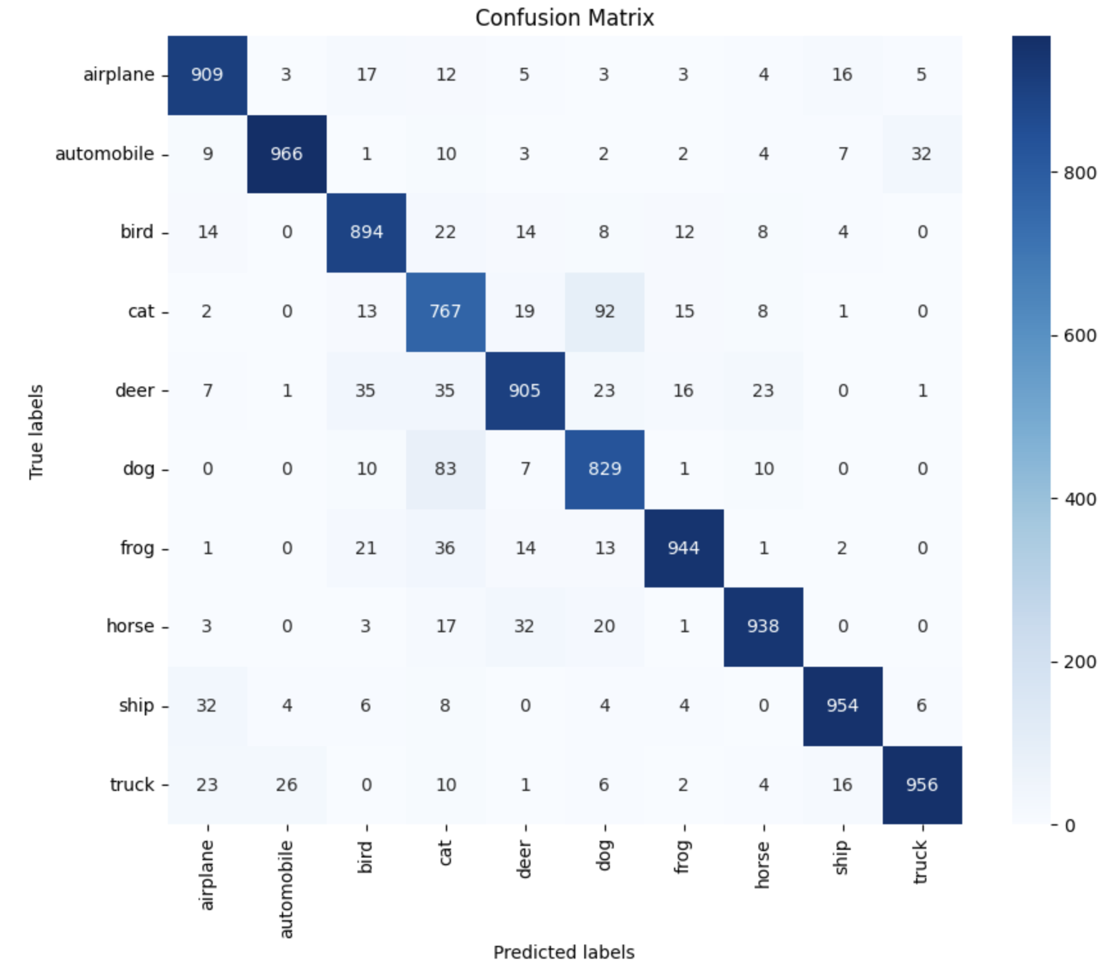
Transfer Learning

Slide 14
Evaluation
Model | Test Accuracy | Test Loss | Training Time
Custom CNN | 86.65% | 0.44 | ~1 hour
MobileNetV2 (Transfer Learning) | 90% | 0.30 | ~ 2 hour

Slide 15
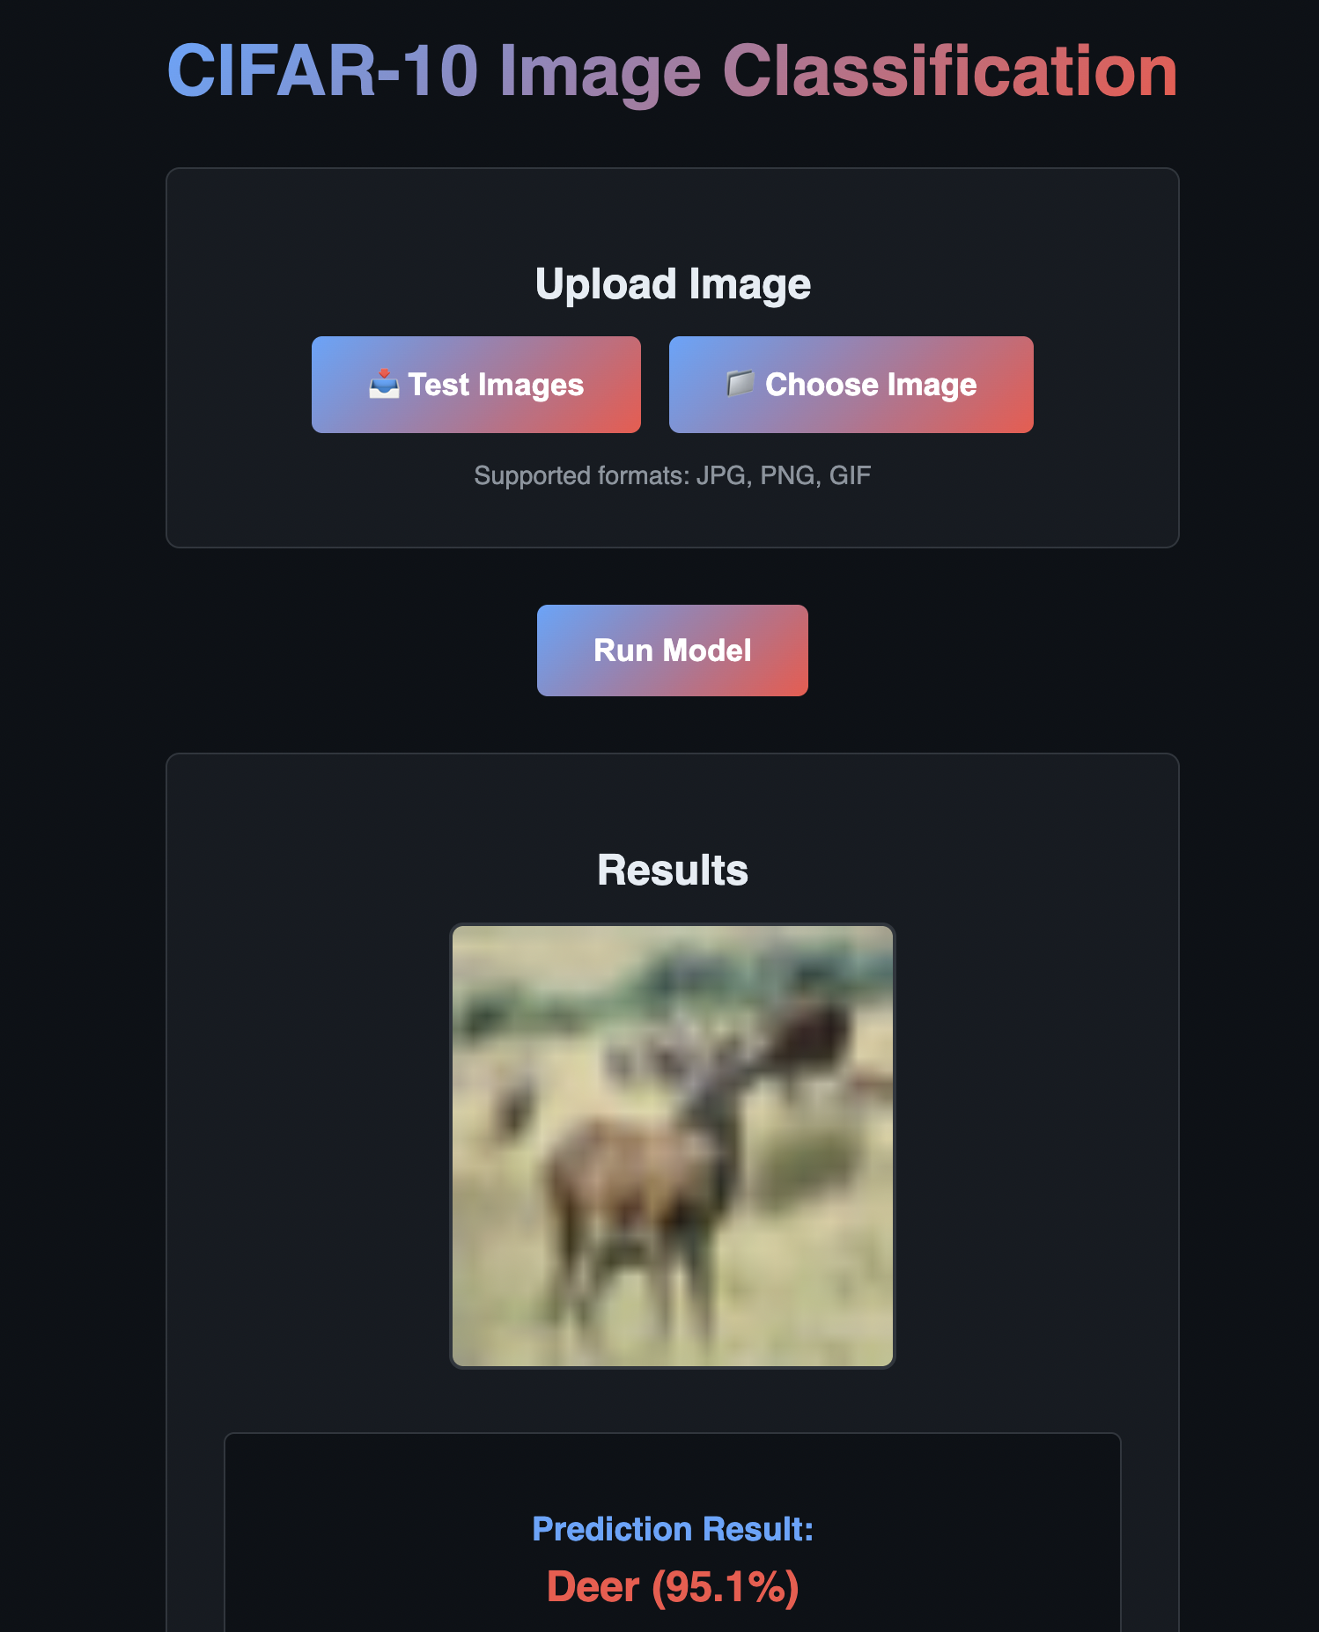
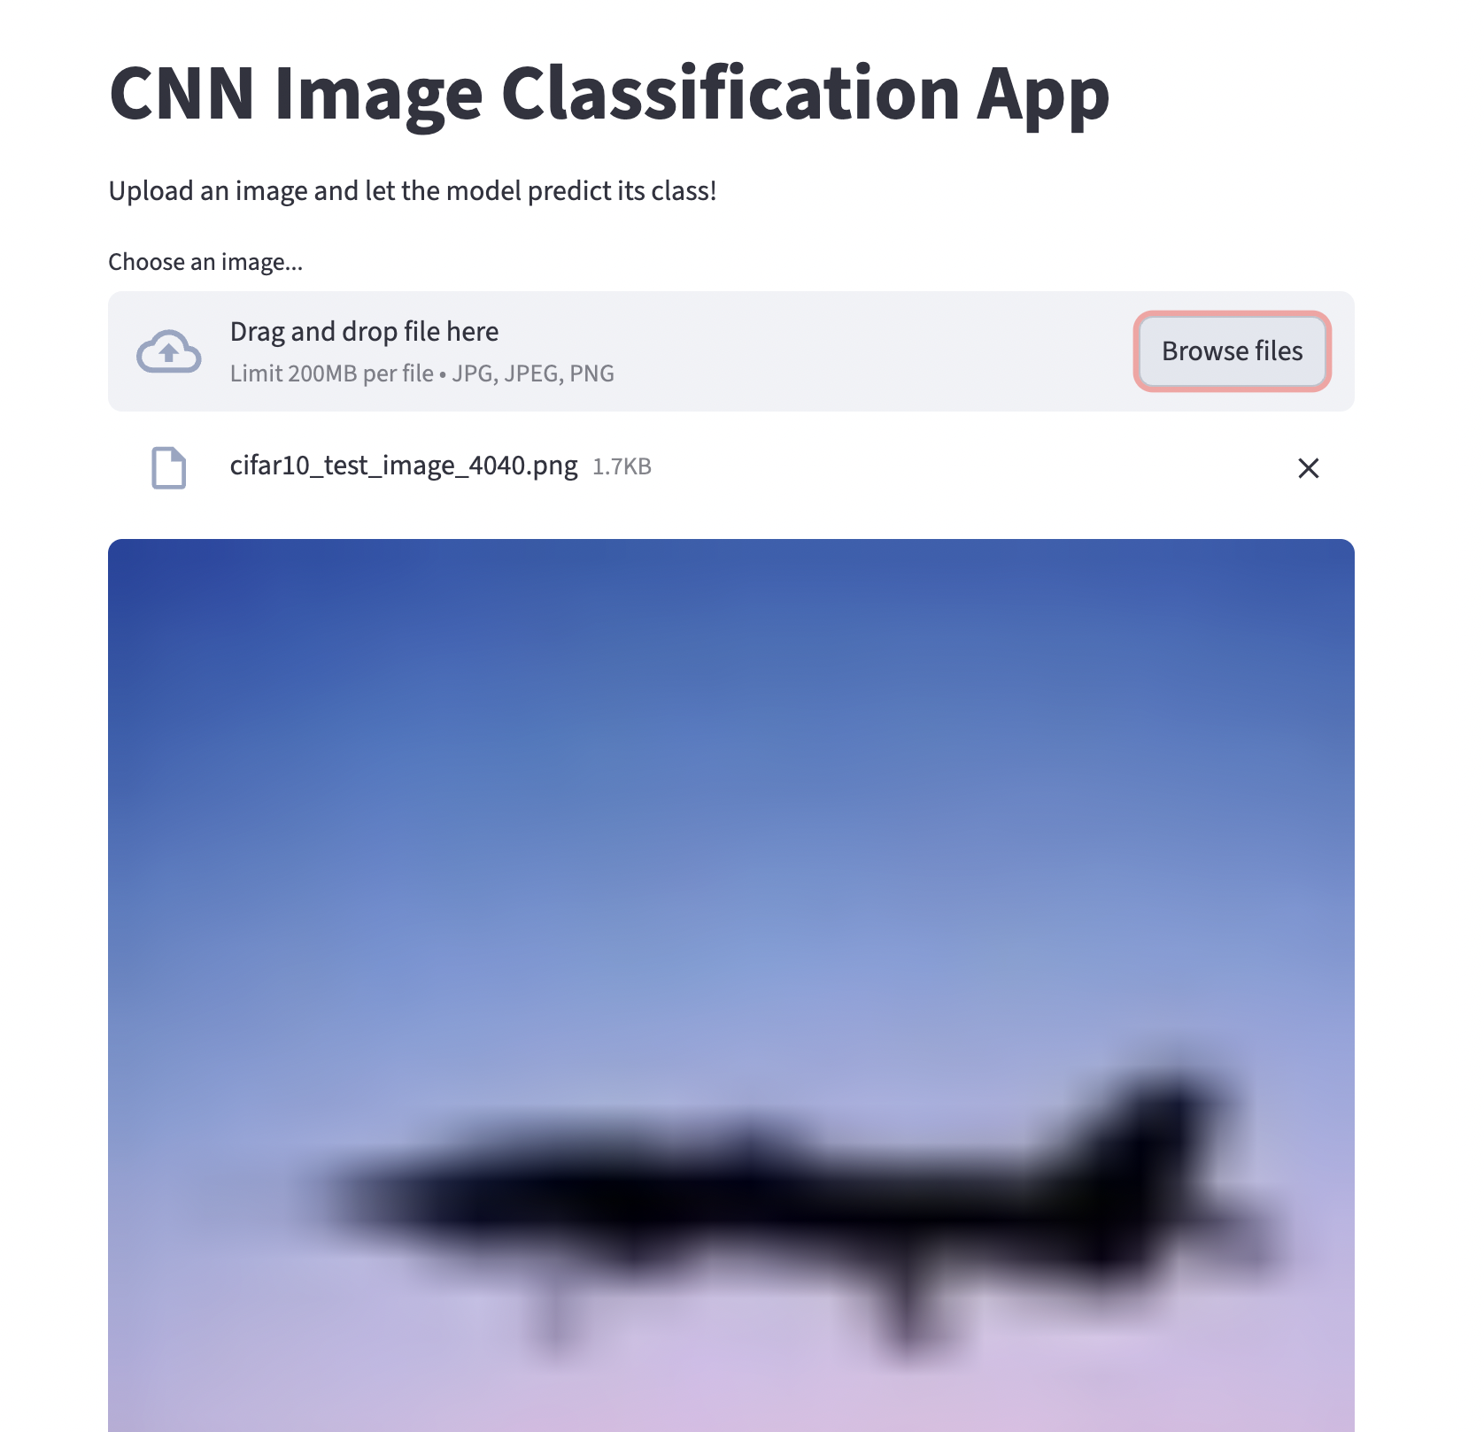
Model Deployment
https://maleckicoa.com/demo-apps/cifar-10
https://g1-project-classifier.streamlit.app/

Slide 16
Overview
Data preprocessing and augmentation are essential to avoid overfitting.
Transfer Learning can significantly improve results, but at a computational cost.
Optimization techniques (Early Stopping, LR scheduling, Dropout, L2) were crucial for stability.

